Slide 1

Bengal College of Engineering and Technology
Title - Deepfake Detection
Group NO :- 4 4th year, 7th sem Branch : Information Technology
Priyabrata Dey : | 12500222110
Preetimoy Low : | 12500222096
Nitish Ghosh : | 12500222097
Bikash Ch Kuiry : | 12500222094

Slide 2

What is DeepFake ?
Deepfake refers to synthetic media generated using advanced artificial intelligence techniques that convincingly manipulate or entirely fabricate visual or audio content, making it appear authentic while misrepresenting reality.

Slide 3
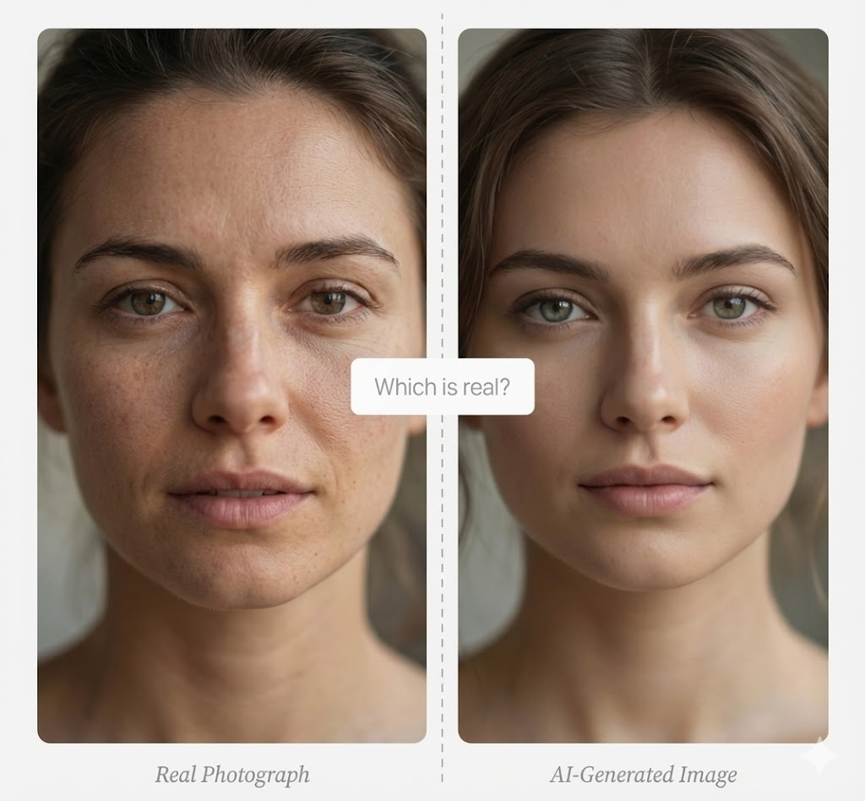
Synthetic Media and the Crisis of Authenticity
Why Modern Deepfake Detection Is Necessary ?
The Problem
Deepfake technology and Generative AI are now widely accessible.
The Risk
Used for misinformation, fraud, and reputational damage.
The Challenge
Human eyes and older models fail to detect realistic, new-gen AI images.
The Need
Automated, accessible tools are required to keep pace with evolving AI.

Slide 4
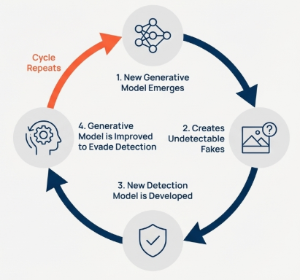
The Detection Challenge: An Escalating Technical Arms Race
Synthetic media detection is a continuous arms race. As detection techniques improve, generative models are rapidly trained to bypass them, causing older methods to lose effectiveness and requiring constant adaptation
The Failure of Legacy Models
Early detection models, often based on traditional CNNs, are not equipped to identify the subtle artifacts of modern diffusion-based generators.
The Problem of False Negatives
Our initial tests confirmed this: generic deepfake models failed to detect images created by modern tools like Meta AI, producing critical false negatives.

Slide 5
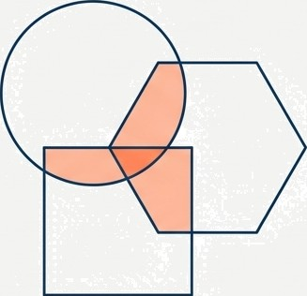
Our Objective:
Engineering a Resilient, Multi-Faceted Detection System
Project Goal
To engineer a user-friendly, cloud-based tool capable of accurately detecting a diverse range of Al-manipulated imagery, from traditional deepfakes to state-of-the-art generative content.
Our Strategic Approach: The Ensemble
Instead of relying on a single, fallible AI model, we architected an 'Ensemble' system.
This approach combines the strengths of multiple specialist AI models to
maximize detection coverage and resilience against new manipulation techniques.
Core Technology
The system is built upon modern Vision Transformer (ViT) architectures, selected for their superior ability to capture global image inconsistencies compared to traditional CNNs.

Slide 6
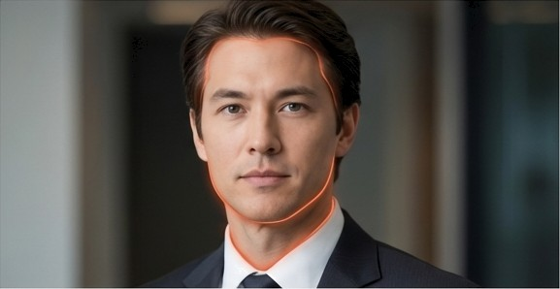
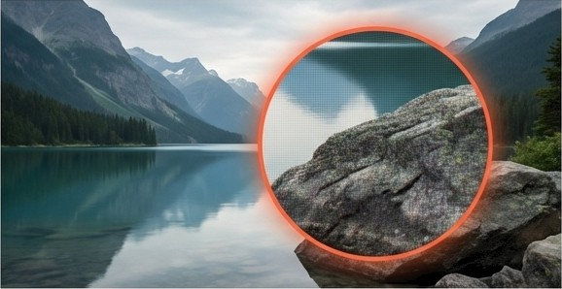
Heterogeneous nature of Deepfake
Different generative techniques leave fundamentally, different forensic traces. A model trained to spot one type of manipulation is often blind to another.
Category 1: Face Swaps
Traditional deepfakes that involve pasting one person's face onto another's body. These create stritCfuraf and boundary inconsistencies.
Category 2: Purely Synthetic Generation
Images created entirely from text prompts by diffusion models (e.g., Stable Diffusion, Meta AI). These contain microscopic texture and noise artifacts.

Slide 7


Double Vision:
Combining Two Models for Smarter Deepfake Detection
Model 1: The Structural Analyst
dima806/deepfake vs real image detection
Architecture: A fine-tuned Google Vision
Transformer (ViT).
Expertise: Specialises in detecting 'Face Swaps' and traditional deepfakes. It eacels at analysing the overall structure of an image to find inconsistencies where digital elements have been 'stitched' together.
Model 2: The Artifact Hunter
0rganika/sdx1—detector
Architecture: A fine-tuned Swin Transformer.
Expertise: Specifically trained to detect the microscopic digital artifacts and noise patterns unique to modern diffusion models like Stable Diffusion and Meta AI.

Slide 8
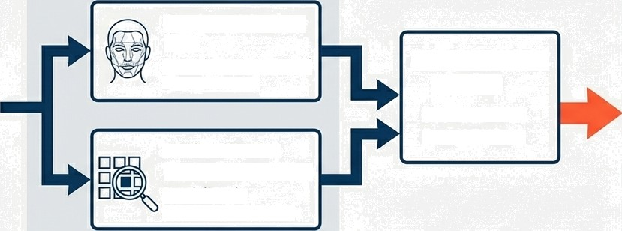
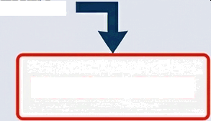
The Ensemble Logic:
A Two-Pronged Verification Process
To maximize detection coverage, the system flags an image as ‘Fake’ if either specialist model reports a high probability of manipulation. This creates a robust safety net.
1. Parallel Analysis
Structural Analyst
(ViT)
Specialises in structural inconsistencies
2.Independent Scoring
Score A: 0.12
Score B: 0.99
3. Final Verdict
IF Score A > Threshold
OR
Score B> Threshold
THEN...
Artifact Hunter (Swin Transformer)
Specialises in
microscopic artifacts
Verdict
FAKE or REAL

Slide 9
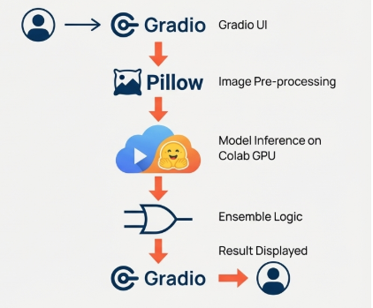





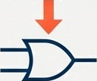


Implementation: The Technology Stack and Workflow
Development Environment
Google Colab: Utilised for its cloud-based Python runtime, providing access to high-performance GPUs necessary for running multiple advanced transformer models.
_{C}o₋ Gradio
GradioUl
Pillow
Image Pre-processing
Core Libraries
Transformers (from Hugging Face): For downloading, managing, and running the pre- trained ViT models.
Pillow (PIL): For all back-end image processing and preparation tasks.
Gradio: To rapidly build and deploy an intuitive, web-based drag-and-drop user interface for the system.
Model Inference on Colab GPU
Ensemble Logic
Result Displayed
º Gradio ••
C -

Slide 10
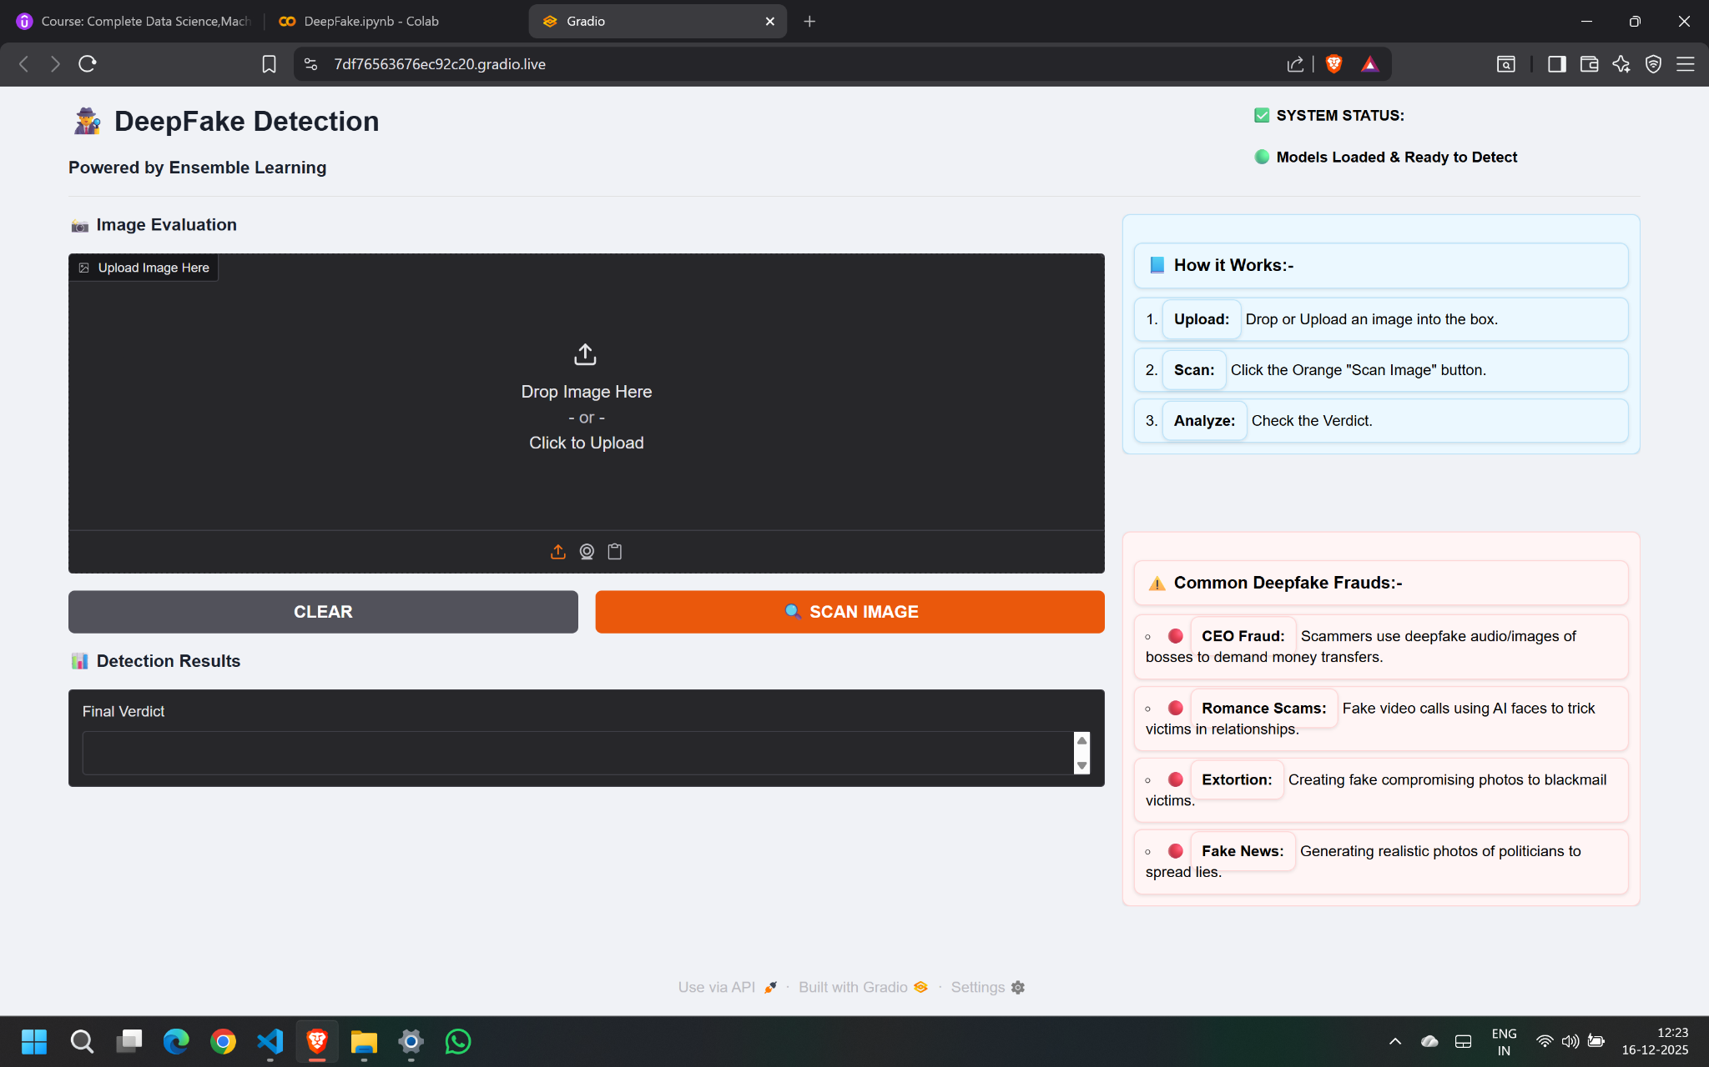
System Demonstration:
Interface of the Tool build with gradio
The front-end interface of the tool is built using Gradio, providing a clean, lightweight, and interactive web-based experience.

Slide 11
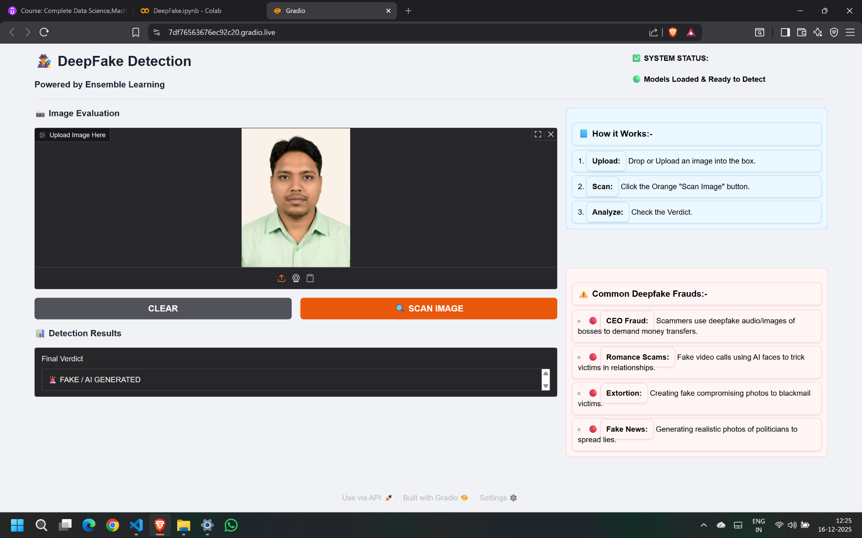
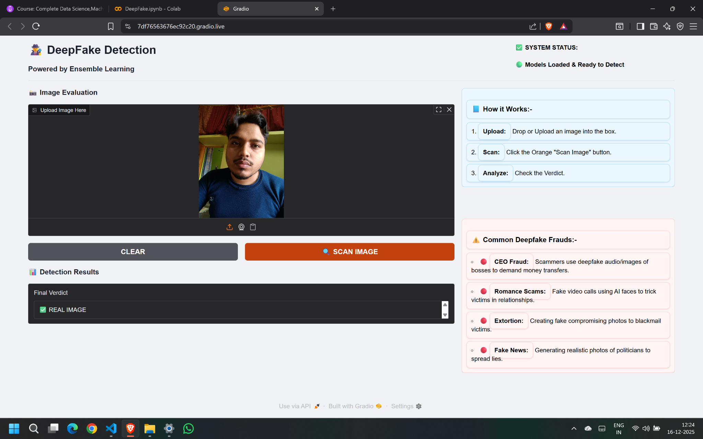
System Demonstration:
Achieving »99% Confidence on Modern AI Imagery

Slide 12

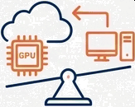
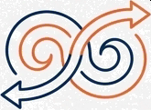
Key Engineering Learnings and iterations
1. The Necessity of
Specialization
2. Managing Computational Resources
Continuous Evolution in Detection Systems
Generic deepfake models produced false negatives on modern AI images. Switching to a diffusion-trained model (Organika/sdxl-detector) resolved this, reinforcing that the right tool matters.
Simultaneous Vision Transformer models demand heavy resources, making cloud-based GPUs (Google Colab) more practical than local deployment.
The project highlights that an effective detection system cannot be static and must be designed for continuous evolution.

Slide 13
Project Execution and Team Roles
Research and Model Determination
Led the research phase, including the critical analysis and selection of the two distinct Vision Transformer architectures to form the core of the ensemble.
Nitish Ghosh
Drove the core project implementation. Their work focused on
integrating the models, codin: work focused on integrating the
models, coding the ensemble logic, and building the Gradio user interface for deployment.
Implementation and Execution
Priyabrata Dey & Preetimoy Low
Testing and Validation
Managed the crucial testing and validation phase, sourcing diverse real-world and synthetic image datasets to rigorously evaluate the system's performance and identify potential weaknesses.
Bikash Chandra Kuiry

Slide 14
Conclusion and Strategic Roadmap
Project Conclusion
Future Scope of Improvement
Scope 1
Extend the system's functionality to process video files by analysing streams frame-by-frame.
Scope 2
Develop the tool into a scalable API, enabling integration with social media platforms or content moderation workflows for automated content flagging.
Scope 3
Establish an automated pipeline to fine-tune and update the underlying detection models as new generative techniques emerge, ensuring long-term relevance in the ongoing ’arms race'.
We have successfully engineered and validated a robust, multi-model deepfake detection prototype. By leveraging the complementary strengths of specialised Vision
Transformers within an ensemble architecture, our system effectively identifies both traditional face manipulations and imagery from modern generative AI.

